Slide 1
Lesson 17: Combined Mode Control
ET 438a Automatic Control Systems Technology

Slide 2
Learning Objectives
After this presentation you will be able to:
Describe the common control mode combinations used in analog control systems
List the characteristics of combined control modes
Write the time, Laplace and transfer functions of combined control modes
Identify the Bode plots of combined control modes
Design OP AMP circuits that realize theoretical combined control mode performance.

Slide 3
Proportional-Integral Control
Control Mode Characteristics:
1. Proportional action produces fast response to large load changes.
2. Integral action drives output to zero steady-state error.
3. Adds one pole and one zero to system transfer function.
4. Used on systems that have large load changes and where proportional only action fails to reduce steady-state error to acceptable limits.

Slide 4
Proportional-Integral Control
Mathematical Representations
Time Function:
All initial conditions set
to zero in transfer function
Laplace Function:
zero
Transfer Function:
pole
Proportional-Integral (PI) Controllers add a pole at s=0 and zero at s=0 to system transfer function

Slide 5
Proportional-Integral Control Response
Time plots of PI controller
output for piece-wise linear
error input
Proportional mode
gives instantaneous response
to error while integral mode
decrease error over time.
Constant error produces linearly increasing controller output

Slide 6
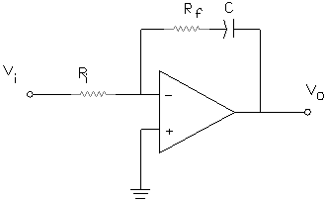
OP AMP Realization of PI Controller
PI Controller Circuit
Derive the transfer function from the generalized gain formula for inverting OP AMP circuits
Controller introduces a pole at s=0
and zero at s=-1/R_{f}C
Simplify

Slide 7
Bode Plot of PI Controller
Let R_{i} = 10 kΩ, R_{f} = 100 kΩ and C=0.01 μF then produce Bode plot
MatLAB Code
ri=input('Enter value of input resistance: ');
c=input('Enter value of capacitance: ');
rf=input('Enter value of feedback resistance: ');
% compute transfer function model parameters for
% PI controller
% compute numerator parameter
tau=rf*c;
% compute parameter for denominator
tau1 = ri*c;
% build transfer function
% denominator form a1*s^2+a2s+a3
Av=tf([tau 1],[tau1 0])
%plot graph
bode(Av);

Slide 8
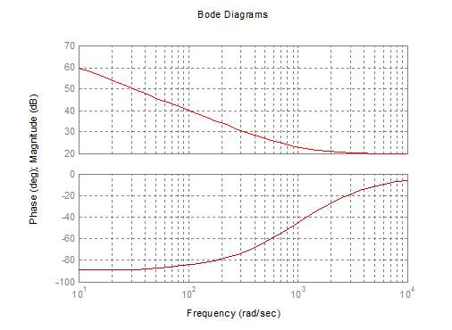
Bode Plot of PI Controller
Integral
action is below
1000 rad/sec.
1/R_{f}C set break point
Integral
Action
Proportional
Action

Slide 9
PI Controller Design
Example 17-1: Design a PI OP AMP controller with K_{p} = 100 and an integral break frequency of 100 rad/sec. R_{i} = 10kΩ
Answer
Answer

Slide 10
Proportional-Derivative Control Mode
Proportional-Derivative (PD) Control combines proportional and derivative actions. Used in processes that have sudden load changes that proportional only cannot handle.
Mathematical Representations
Time Function:
Laplace Function:
Transfer Function:

Slide 11
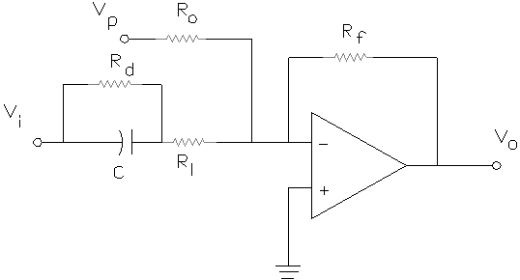
OP AMP Realization of PD Controller
OP AMP PD circuit
Note: 1/K_{d} = the derivative action break point frequency
1/αK_{d} = limiter action break point frequency
0≤α≤1

Slide 12
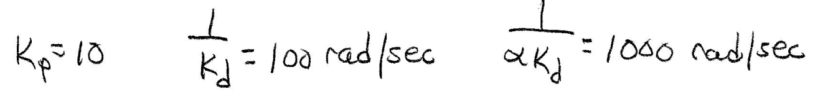
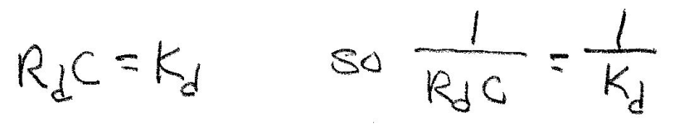
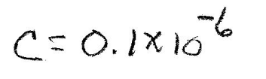
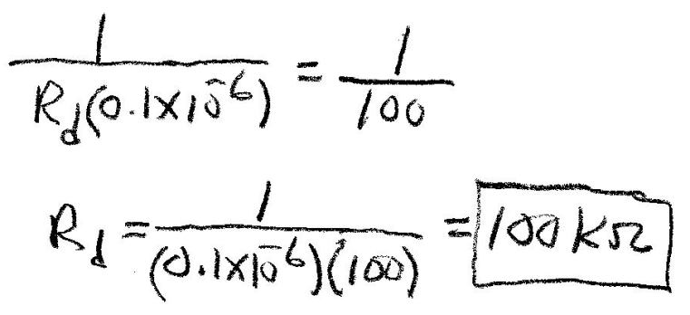
PD Controller Design
Example 17-2: Design a PD control that has a proportional gain of 10 a derivative action break point of 100 rad/sec and a limiter frequency break point of 1000 rad/sec. C = 0.1 μF. Draw the OP AMP circuit and place all values on the schematic.
Example 17-2 Solution
Answer

Slide 13
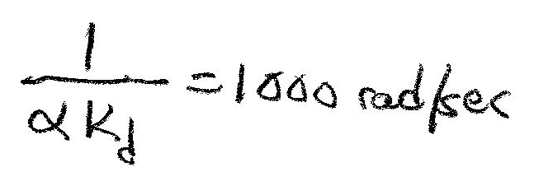
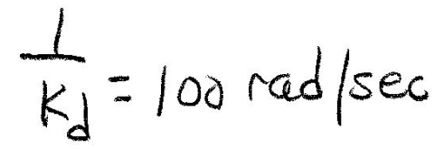
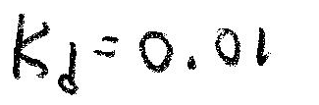
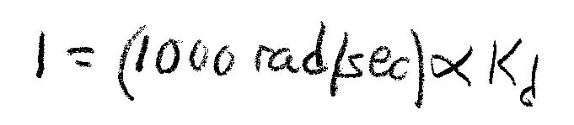
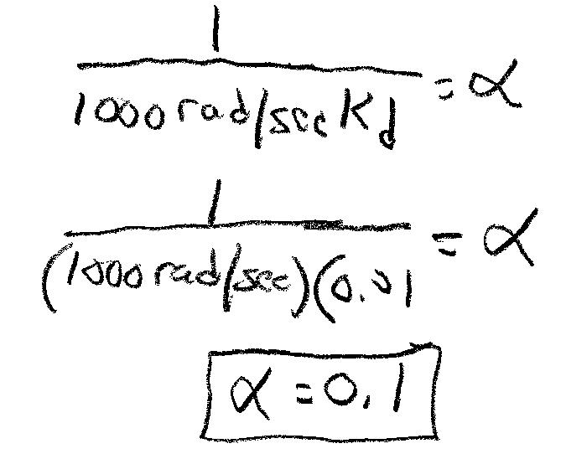
Example 17-2 Solution (2)
Now compute the alpha value from the rate limit break frequency
Answer

Slide 14
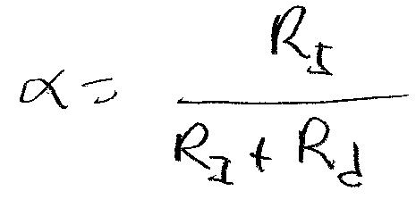
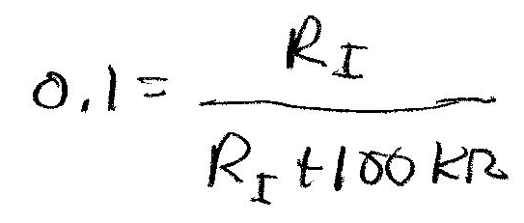
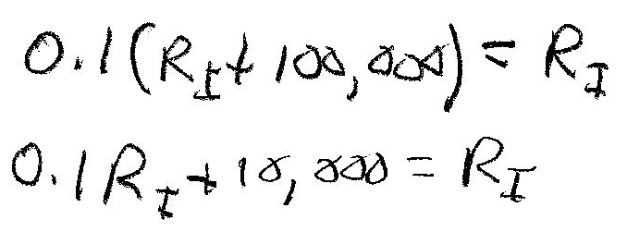
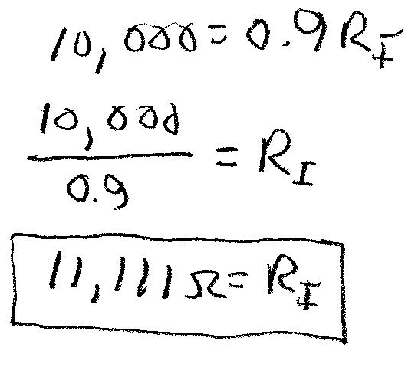
Example 17-2 Solution (3)
Now find the value of R_{I}
From previous calculations R_{d} = 100 kΩ and α=0.1
Answer

Slide 15
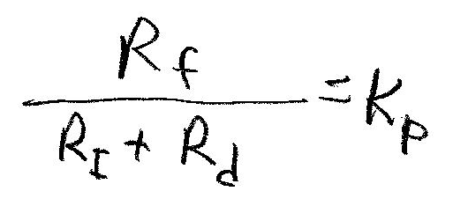
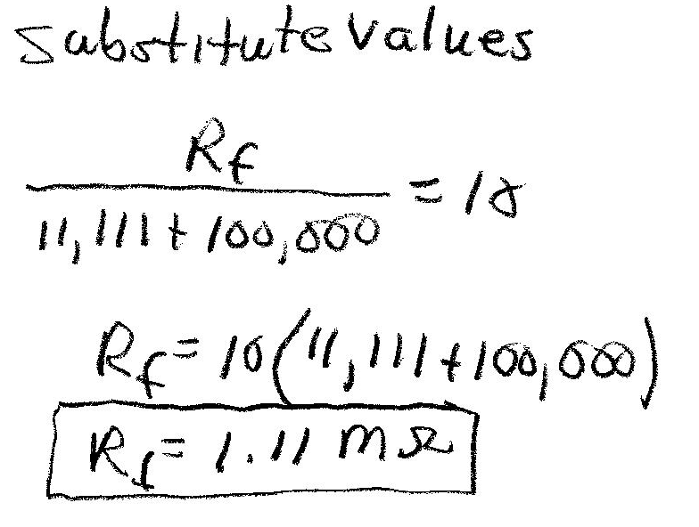
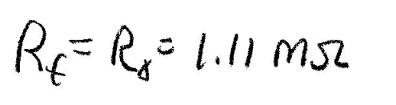
Example 17-2 Solution (4)
Find R_{f} and R_{o} use proportional gain and previously computed values
Answer

Slide 16
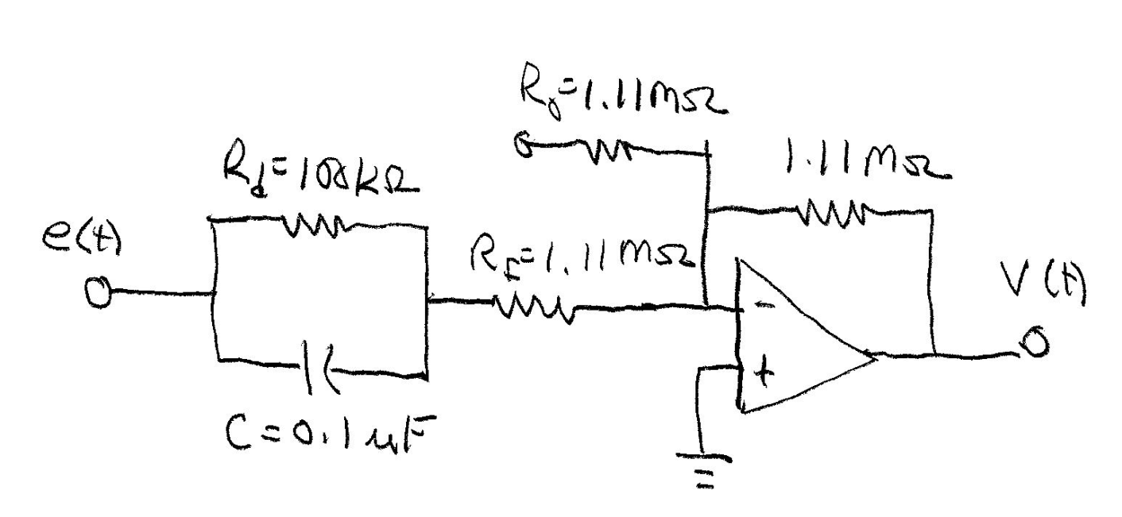
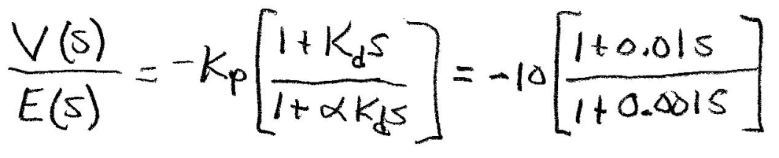
Example 17-2 Solution (5)
Draw OP AMP Schematic and label components
Transfer function
Negative sign causes 180 degree phase shift due to inverting configuration. Add
Inverting OP AMP circuit with gain of -1 to remove this

Slide 17
PD Bode Plot
Use MatLAB to generate the Bode plot of the PD controller designed in Example 17-2
MatLAB Code
ri=11.11e3;
c=0.1e-6;
rf=1.111e6;
rd=1e5;
% compute transfer function model parameters for
% PD controller
% compute parameters
kd=rd*c;
alpha=ri./(ri+rd);
kp=-rf./(ri+rd);
% build transfer function
% denominator form a1*s^2+a2s+a3
% numerator for b1*s^2+b2s+b3
Av1=kp*tf([kd 1],[alpha*kd 1])
%plot graph
bode(Av1);
Define variables
Compute parameters
Generate transfer function and plot response

Slide 18
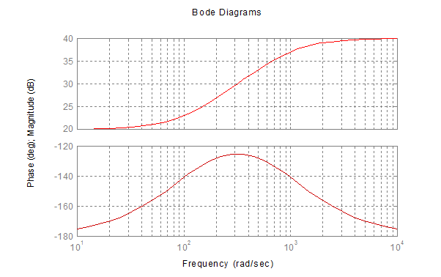
PD Bode Plot
Computed transfer function
-0.1 s - 10
---------------
0.001 s + 1
Derivative
Break f
Rate limit
Break f

Slide 19
Proportional + Integral + Derivative Controllers
Proportional-Integral-Derivative (PID) Controller Characteristics:
1. Proportional mode provides fast response to large process load changes
2. Integral mode removes the steady-state (offset) error from the output
3. Derivative mode improves system stability and improves response to rapid load changes.
4. Widely used in industry

Slide 20
Mathematical Relationships for PID Controllers
Time Function:
Laplace Function:
Transfer Function:

Slide 21
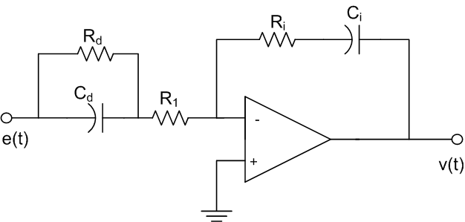
OP AMP Realization of PID Controller
Single OP AMP realization of PID control
Modify system response by changing the values of
K_{p}, K_{d}, K_{I} and α.
Notice that the parameters are dependent on
each other. Changing alpha will also change
K_{p}.

Slide 22
OP AMP Realization of PID Controller
Multiple OP AMPs allow independent adjustment of PID parameters.

Slide 23
OP AMP Realization of PID Controller
Multiple OP AMP Realization
Compute common denominator
Define the follow relationships between components and parameters

Slide 24
Multiple OP AMP PID Realization
Divide numerator and denominator by R_{I}C_{I} and make defined substitutions
Controller adds two zeros and two poles to
System. Change system response by changing
Parameters K_{p} K_{I}, K_{d} α.
Where

Slide 25
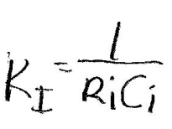
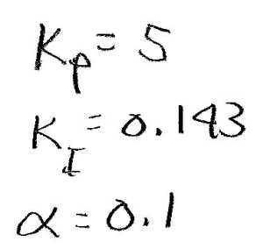
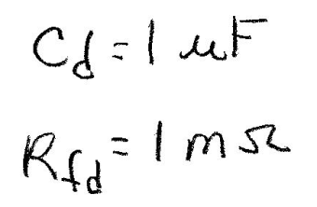
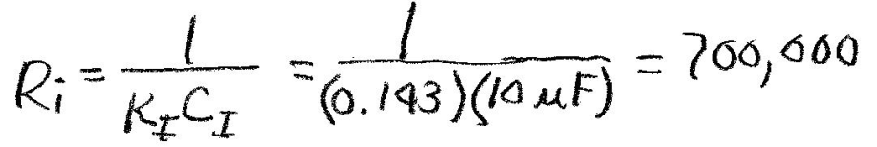


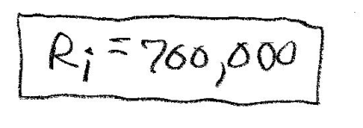
PID Controller Design
Example 17-3: Design a PID controller using the circuit above. Proportional gain is 5. The derivative time constant is 0.5 seconds. The integral gain is 0.143 and α=0.1. The capacitor for the integrator C_{i}=10 μF and the differentiator, C_{d}= 1 μF R_{f} = 1 MΩ. Find values for all other components.
Example 17-3 Solution
Define
parameters
Answer

Slide 26
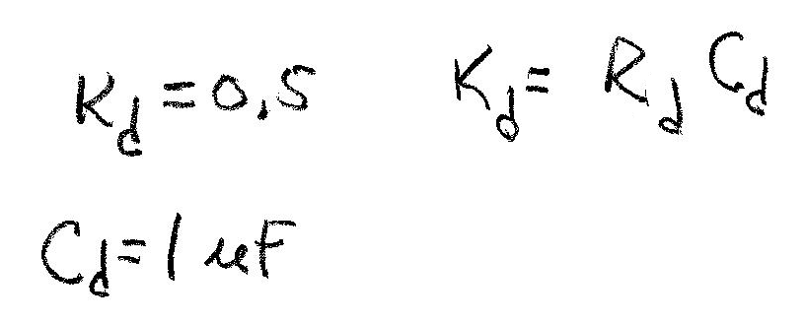
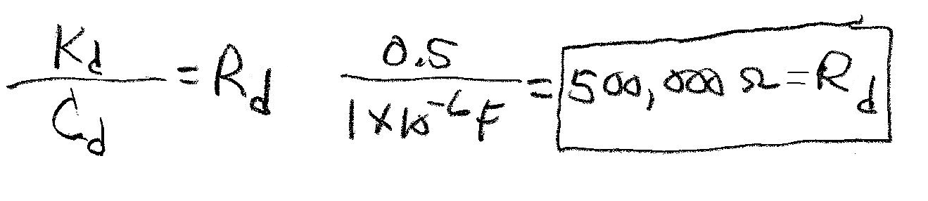
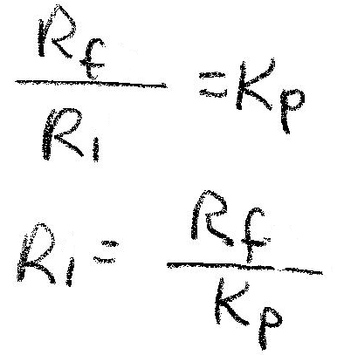
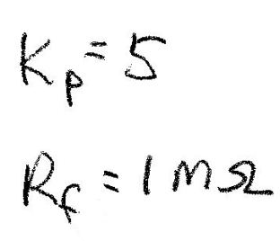
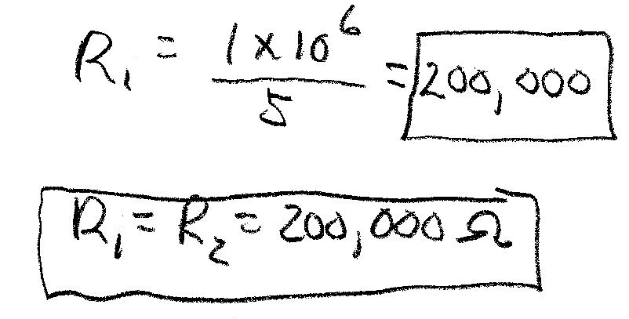
Example 17-3 Solution (2)
Find the feedback resistor value for the differentiator
Answer
Now find the input resistor values for the summing amplifier
Answer

Slide 27
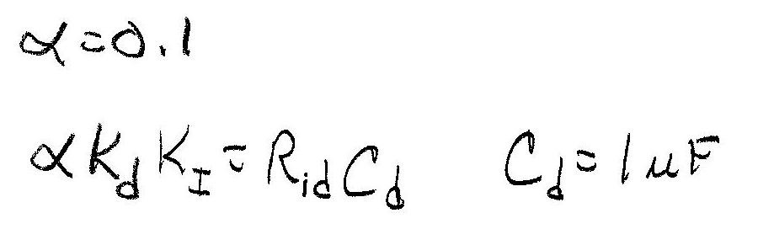
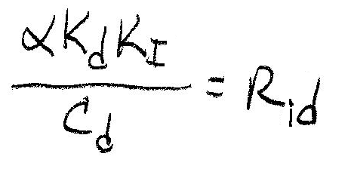
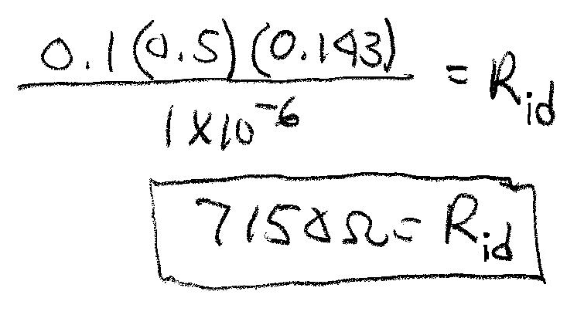
Example 17-3 Solution (3)
Find the input resistor value for the differentiator
Solve for R_{id} and substitute in all known values
Answer

Slide 28
End Lesson 17: Combined Mode Control
ET 438a Automatic Control Systems Technology

